Slide 1
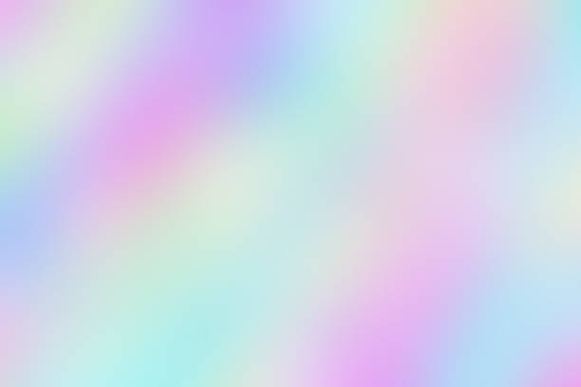
Activity 6 – Enhancing Color Images
Kenneth M. Leo
2015 – 13015
Applied Physics 186

Slide 2
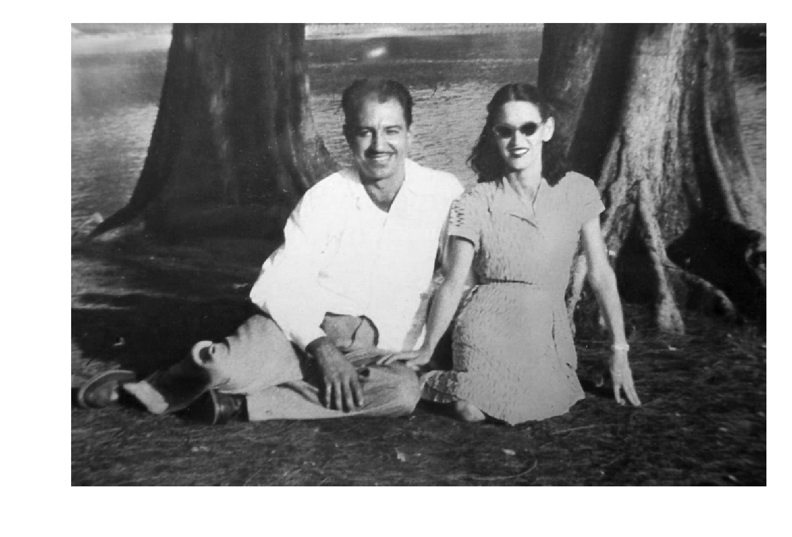
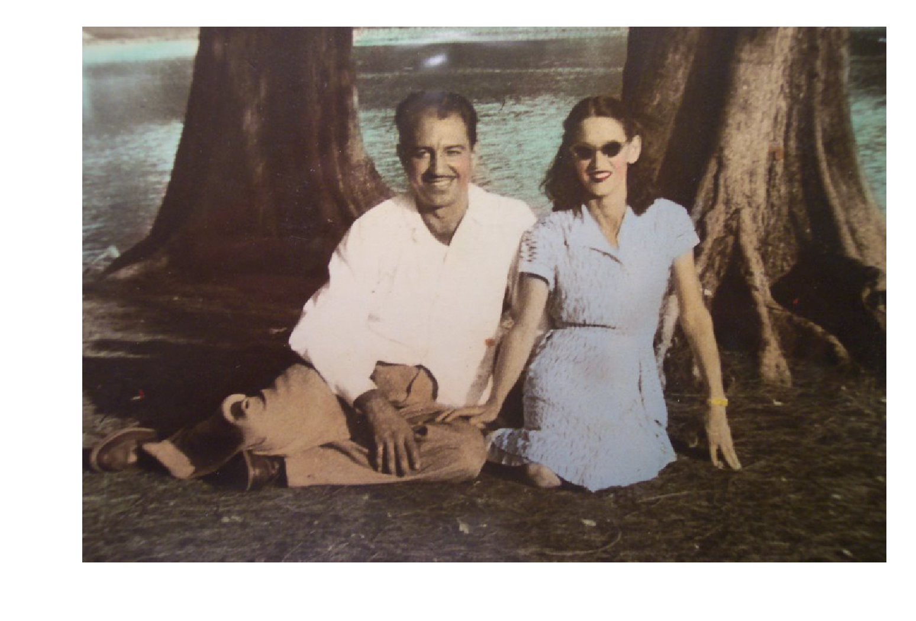
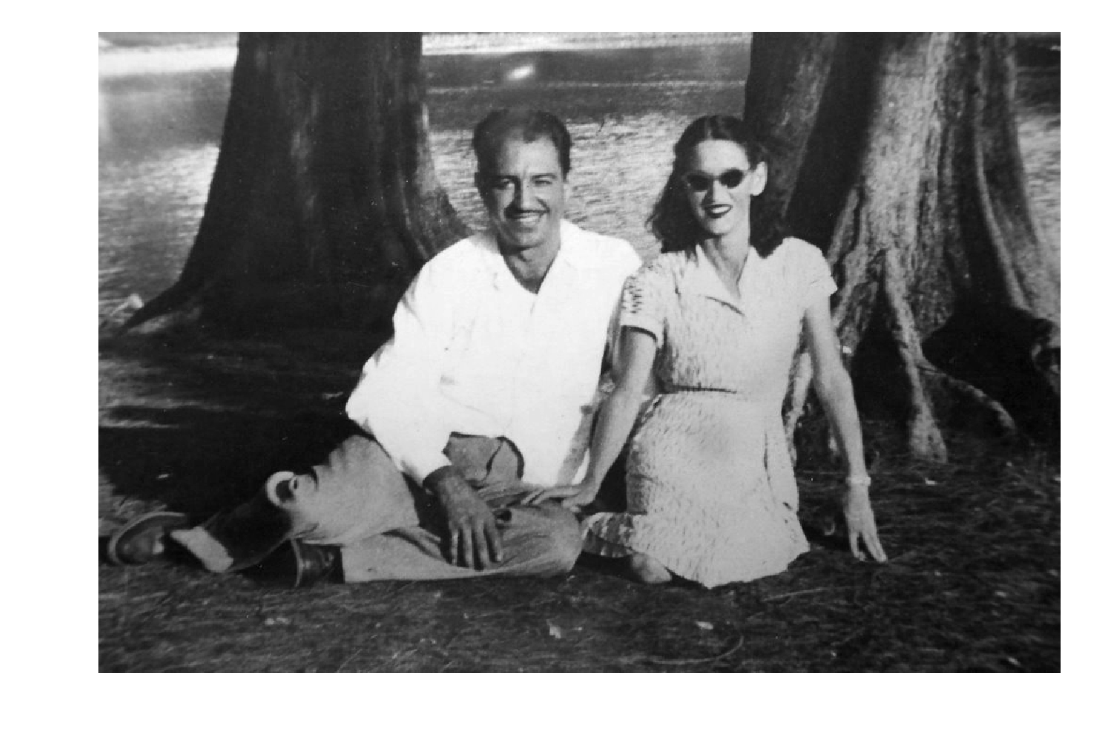
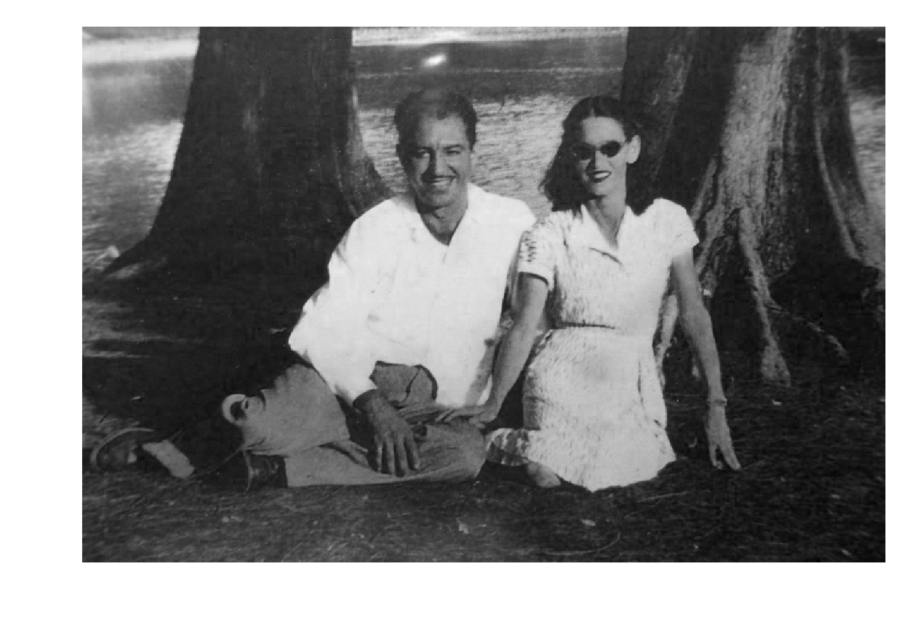
Original Image: Decomposed
Using our eyes, we can already see the difference between the two. The original image has that overall ‘old’ vibe where the whole image looks like it has a low saturation mask. We can also see that the color of the people on the photo is not what it’s supposed to be, which proves that the color of the original image is indeed unbalanced.
Now, looking at the RGB channels, we see that the red channel has the greatest grayscale value sum which means that it is the more dominant color in the photo, which gives it an old vibe.
Red Channel: Sum = 74345539
Green Channel: Sum = 64280861
Original Image
Blue Channel: Sum = 57870689

Slide 3
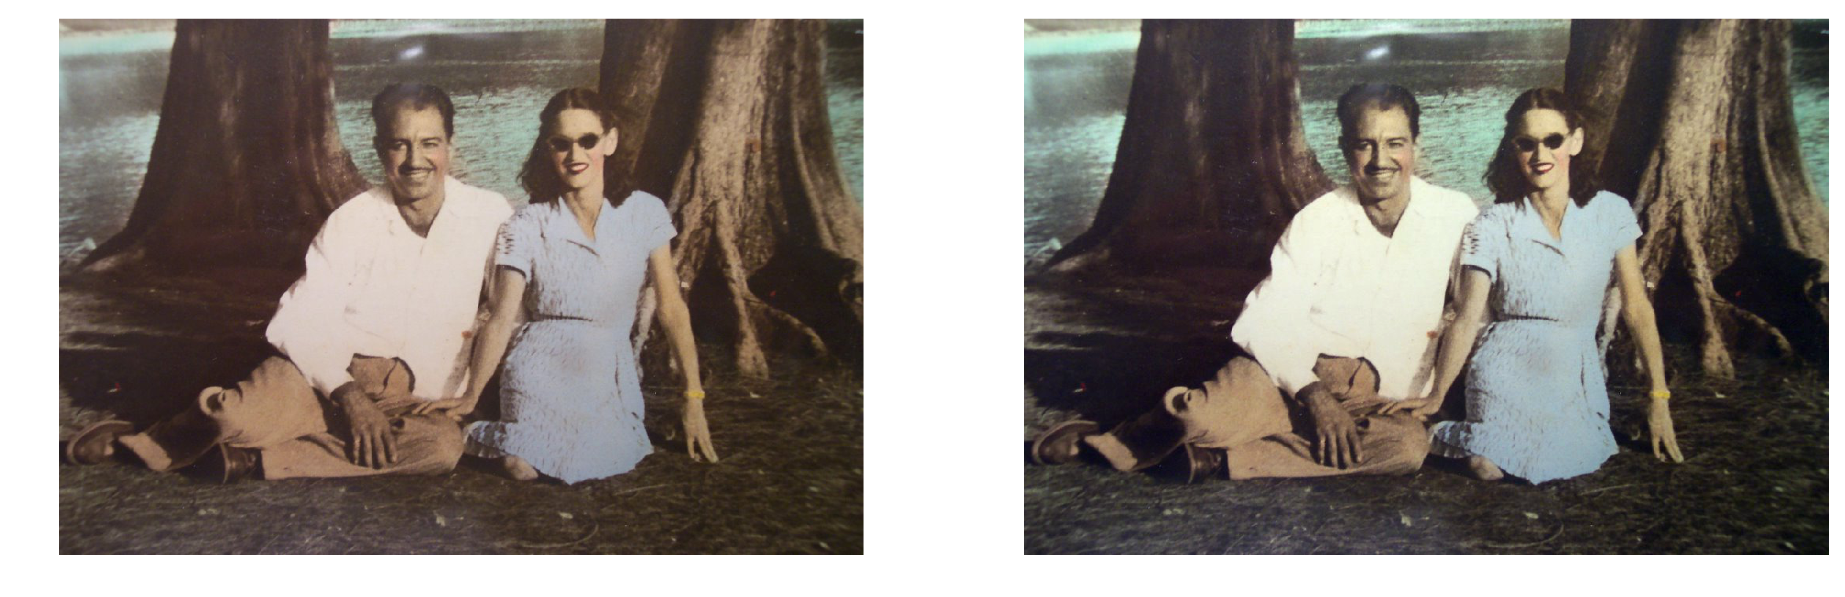
Contrast Stretching Algorithm
Original Image
Contrast Stretched Image

Slide 4
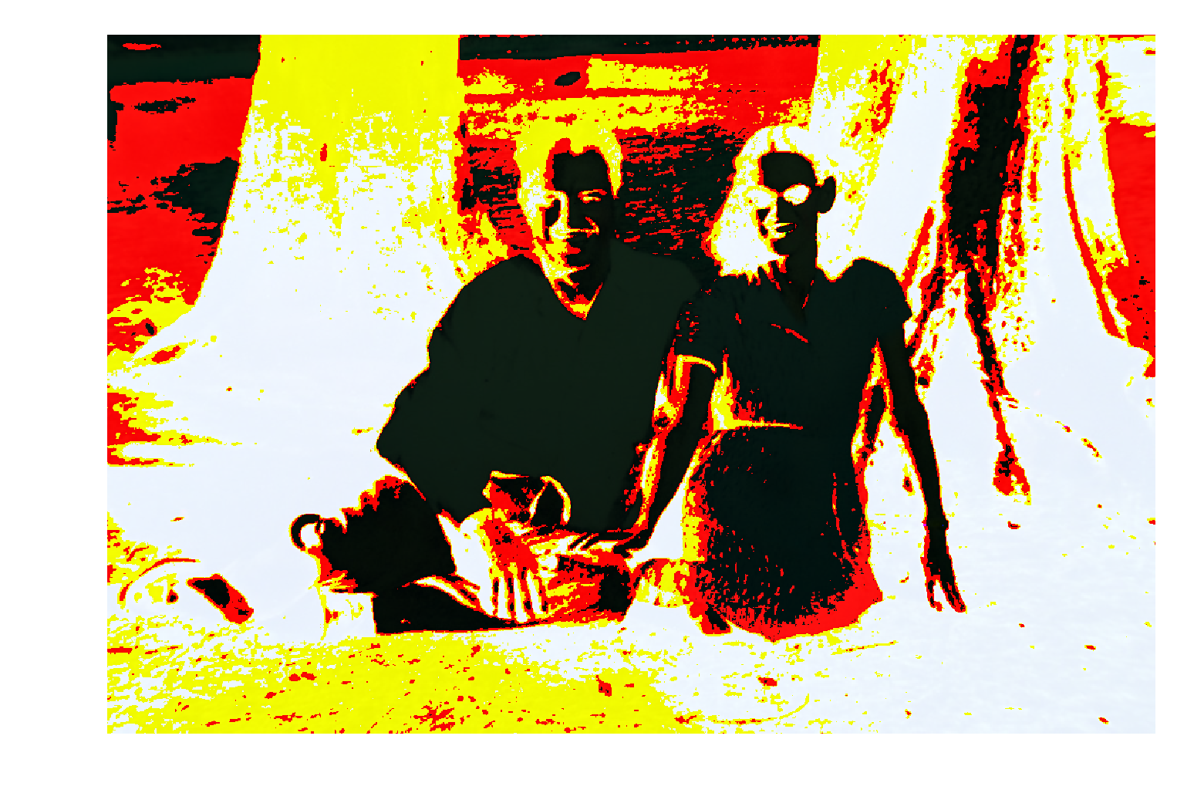
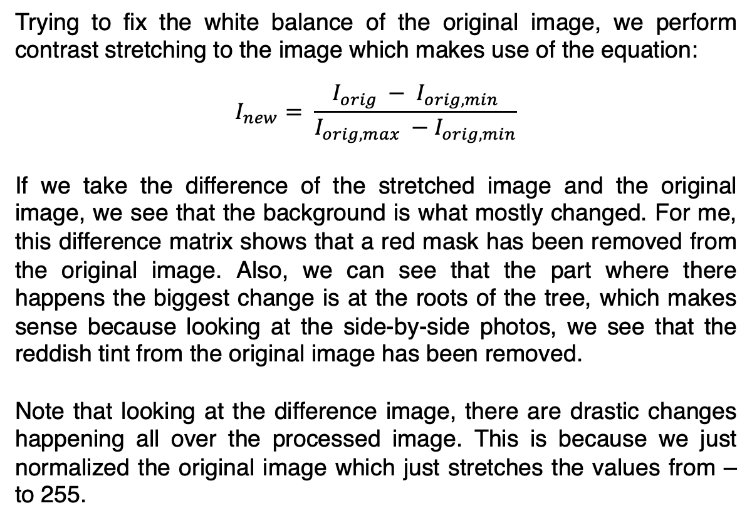
Contrast Stretching Algorithm
Trying to fix the white balance of the original image, we perform contrast stretching to the image which makes use of the equation:
$$I_{new}= \frac{I_{orig} − I_{orig, min}}{I_{orig, max} −I_{orig, min}}$$
If we take the difference of the stretched image and the original image, we see that the background is what mostly changed. For me, this difference matrix shows that a red mask has been removed from the original image. Also, we can see that the part where there happens the biggest change is at the roots of the tree, which makes sense because looking at the side-by-side photos, we see that the reddish tint from the original image has been removed.
Note that looking at the difference image, there are drastic changes happening all over the processed image. This is because we just normalized the original image which just stretches the values from – to 255.
Difference of original and stretched image

Slide 5
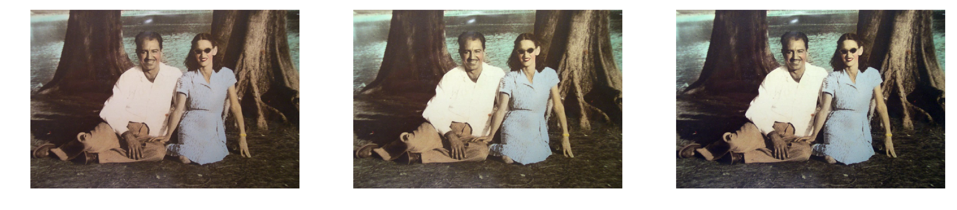
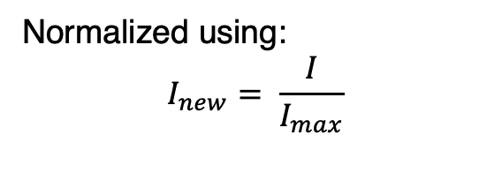
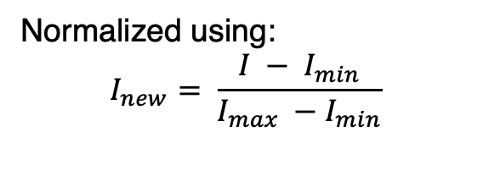
Gray World Algorithm
Original Image
1st gray world Image
2nd gray world Image
Normalized using:
$$I_{new}= \frac{I}{I_{max}}$$
Normalized using:
$$I_{new}= \frac{I − I_{min}}{I_{max} −I_{min}}$$

Slide 6
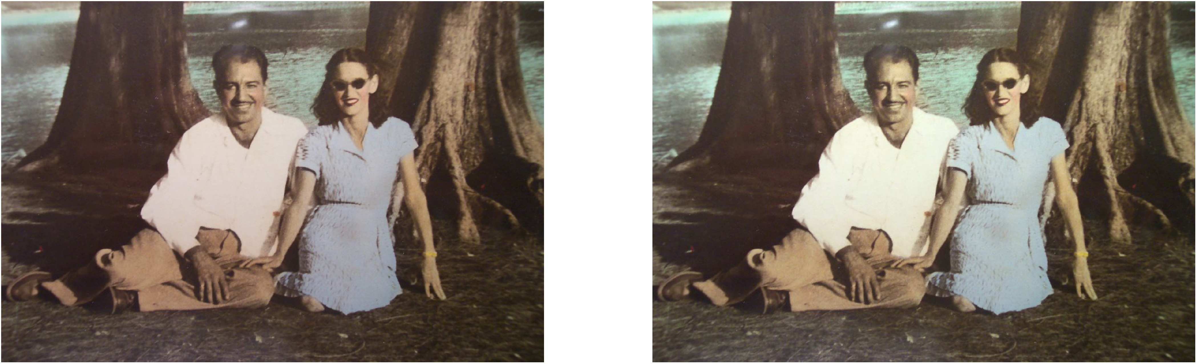
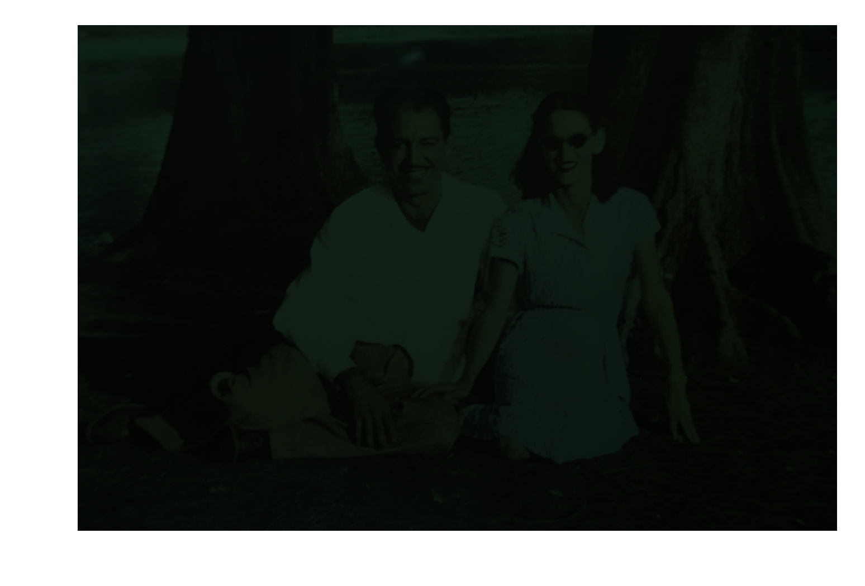
Gray World Algorithm
First gray world image
Compared to the processed image using contrast stretching, we see that the change from the original and the first gray world image photos are less drastic. But we can see a difference. Wee that the overall quality of the image has been changed. Looking at the difference matrix, we see that we changed the values of all the pixels of the image not just certain parts (unlike contrast stretching).
Difference of original and processed image

Slide 7
Gray World Algorithm
Second gray world image
Using the min-max normalization equation, we see that the picture produced is similar to the image that has undergone contrast stretching. Why? This is because the equation used to contrast stretch is the same to the min-max normalization equation. This means that what we got here is useless. So it is better to normalize the image by dividing it with the maximum value.
Difference of original and processed image

Slide 8
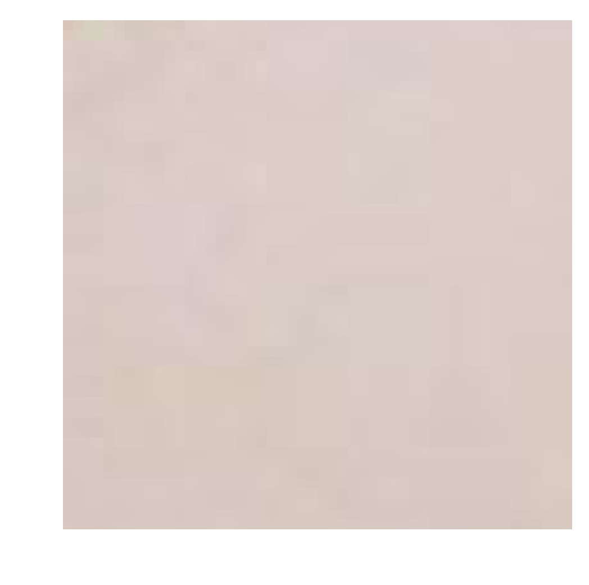
White Patch Algorithm
White patch used
Original Image
1st white patch Image
2nd white patch Image
Normalized using:
$$I_{new}= \frac{I}{I_{max}}$$
Normalized using:
$$I_{new}= \frac{I − I_{min}}{I_{max} −I_{min}}$$

Slide 9
White Patch Algorithm
First white patch image
We can see that the result of the white patch image is kind of similar to the result of the gray world image (both using the first normalization). Subtle change happen but it happened. Hahaha. We can also see that the overall quality of the image is better when compared to the image produced by contrast stretching.
Difference of original and processed image

Slide 10
White Patch Algorithm
Second white patch image
Using the min-max normalization equation, we see that the picture produced is similar to the image that has undergone contrast stretching. But they are not equal. But very similar.
Difference of original and processed image

Slide 11
Summary and Self-evaluation
We can see that the method discussed indeed work. I am pretty sure I can see myself using these methods in the future. Also, based on my personal opinion, Using the gray world is the best way to white balance but we can also use the white patch if there are white patches in the image. But you need to be a hundred percent sure that the patch you’re choosing is indeed white to lessen errors. Contrast stretching is okay if you want to make your image highly contrasted but it kind of makes the image pixelated looking since the colors are not transitioning smoothly from one pixel to another.
Link to notebook used: http://tiny.cc/Activity6AP186
Self evaluation:
Technical Correctness – 5 / 5
Quality of Presentation – 5 / 5
Initiative - 2

